Slide 1
AE2GRP 2015-2016
Lecture 1

Slide 2
Aims (1)
Gain Software Engineering experience:
engineering requirements
system architecture and design
user interface design
implementing a medium sized, multi-component system
systematic testing and debugging
programming in a team
software Engineering tools, especially version management (like Subversion)

Slide 3
Aims (2)
Gain general group working experience:
running meetings
making collective decisions
time and people management
writing reports
giving presentations
interpersonal skills
resolving conflicts (up to a point)

Slide 4
AE2GRP Student Handbook
Student Handbook 2015–2016
everyone expected to read this very carefully!
important dates and deadlines
electronic copies of lecture slides etc.
group division and supervisor assignments
initial project descriptions

Slide 5
AE2GRP in a Nutshell (1)
You have been divided into groups of 5 or 6 students.
Each group is assigned to a supervisor.
The supervisor provides a short written description (project brief) of the software development project to be undertaken.
Weekly formal (with supervisor) and informal group meetings.
Support lectures.

Slide 6
AE2GRP in a Nutshell (2)
Assessment:
Project Site
Written reports:
Interim Group Reports
Final Group Report
Individual Report
Open Day (“trade fair”)
Presentation
Peer assessment

Slide 7
2015-2016 Group List
Posted on Moodle
Group
Supervisor
Project title
Project brief

Slide 8
Support Lectures
Lecture Schedule (Provisional): All lectures will be in TB105, 13:00 -14:00, Thursdays, as follows
17 September 2015, Lecture 1, Meet and Greet, , Reading: Student Handbook
24 September 2015, Lecture 2, Work Organisation and Assessment, Reading: Student Handbook
26 November 2015, Lecture 3, Report Writing and Peer Assessment, Reading: DUP98
21 April 2016, Lecture 4, Presenting your project (Open Day and Presentation Day), Reading: DUP98
Where possible and appropriate, we will organize relevant guest lectures, we will inform you well in advance
Any changes will be advertised in advance
Where possible and appropriate, we will organize relevant guest lectures, we will inform you well in advance

Slide 9
AE2SEM
AE2SEM is a co-requisite for this module (unless you have taken previously)
Designed to support AE2GRP
Covers four main aspects:
The system analysis and design process (UML)
The project management process
Software Quality Assurance (testing, documentation)
Team Software Development Facilities (tools, e.g. version control)

Slide 10
Important Dates
Task | Date or Deadline
Equipment requests | From 5 October 2015
Group project site up and running | Friday 30 October 2015
Interim reports due | Friday 18 December 2015
Final reports and software due | Friday 29 April 2016
Open Day | Wednesday 4 May 2016
Presentation Day | Wednesday 4 May 2016

Slide 11
Time Line
Mid-September – Early October
division into groups
groups contact supervisors
initial group and supervisor meetings
elect group leader
make a rough time plan
October:
background research
turn project brief into initial requirements specification; agree with supervisor
initial design and prototyping
Group project site up and running
30 October Group Project Site Active

Slide 12
Time Line
November
iterate requirements, design, prototypes
start writing interim report
consolidate prototypes/initiate main
implementation effort
December
Start writing interim report
implementation well under way
18 December: Interim Group Report due.

Slide 13
Time Line
January/February/March/April (there is a Chinese new years holiday in between):
implementation,
testing, debugging;
system integration;
start writing up,
finish report.
29 April: final reports and software due
End April–Early May: fine-tune implementation;
prepare Open Day and Presentations.
4 May: Open Day
4 May: Presentation Day

Slide 14
Group Project Site Active: 30 October 2014
Each group gets a School-hosted project site
Initial configuration and demonstration that all group members knows how to use site
completed by 30 October 2015.
Further details – CS Technical Support, Joseph Zhang <Joseph.Zhang@nottingham.edu.cn>

Slide 15
Interim Group Report: 18 Dec 2015
Updated and expanded problem description.
Background: technical background, related
work; existing similar solutions.
Requirements.
Design of system and user interface.
Results of initial implementation efforts.
Fairly detailed time plan. (Develop early, and don’t forget to factor in exam revision, other major activities, holidays . . . , keep updating it)

Slide 16
Final Group Report: 29 April 2015
Updated and expanded version of the interim group report.
Discussion on the design and implementation.
Summary of what was achieved.
Reflective comments on the success of the project.
Description of testing (appendix).

Slide 17
Software: 29 April 2015
Submitted electronically only.
Only need to submit what you have written yourselves.
Make sure software (e.g. libraries) from elsewhere is properly attributed.
Software assessed along a number of dimensions, with evidence including the submitted software itself, testing-appendix in main report, Open Day demonstration, etc.

Slide 18
Individual Report: 29 April 2015
Summary of personal contribution.
Reflection on the project, the running of it, and own role within it.
Peer assessment:
peer-evaluation on dedicated form;
written justification of evaluation.
Assessed on report qualities, not on individual contribution!

Slide 19
Open Day: 4 May 2016
“Trade fair”: groups show off their finished applications to fellow students, members of staff, other interested.
Each group sets up a stand:
Posters (School pays printing of one large poster)
Leaflets
Live demo
The overall quality and professionalism of the stands and the people manning them is assessed.

Slide 20
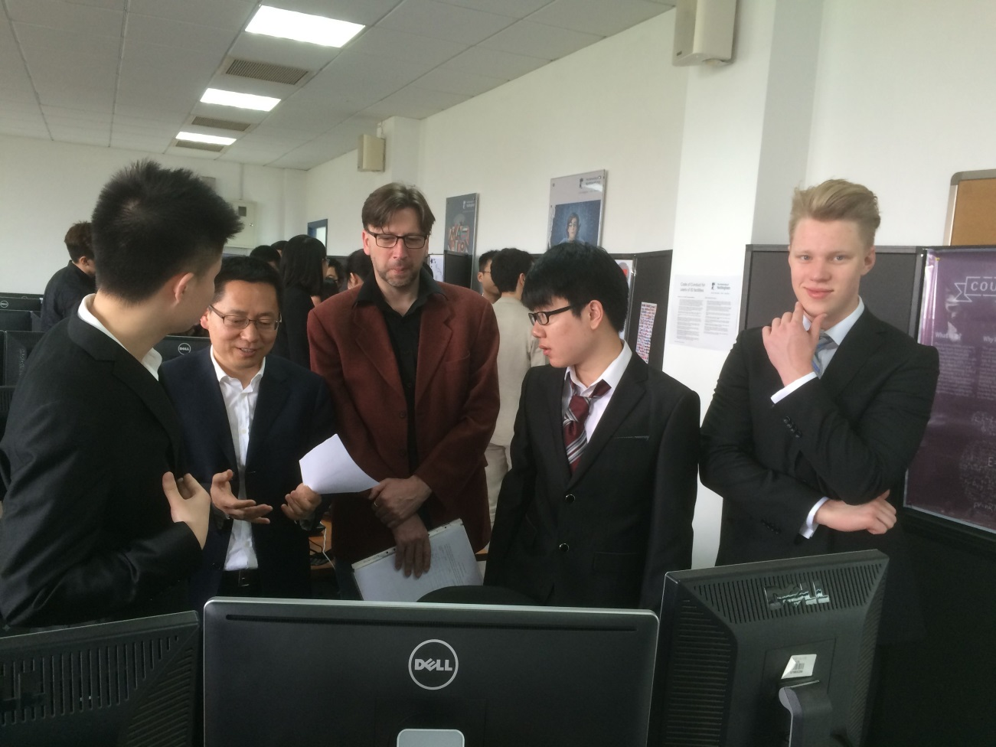
Open Day: 4 May 2016
Some photos of 2015 group project open day

Slide 21
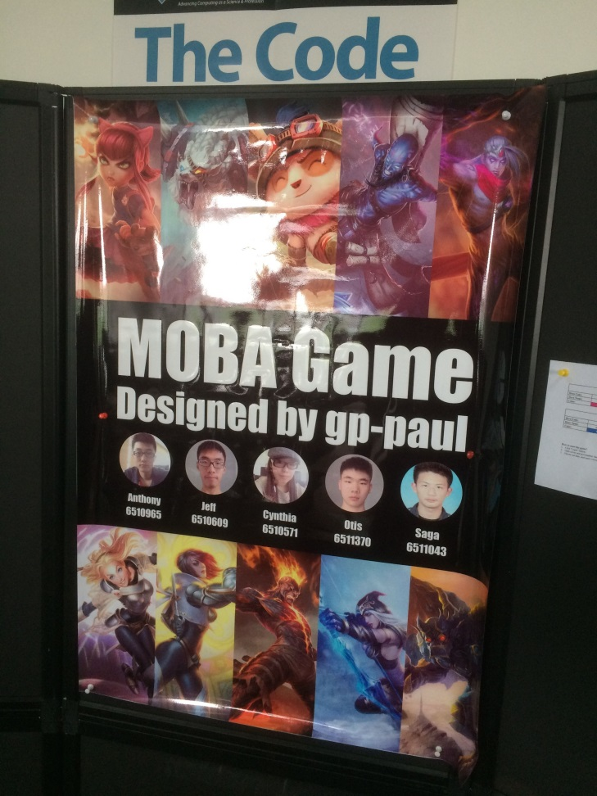
Open Day: 4 May 2016
Some photos of 2015 group project open day

Slide 22
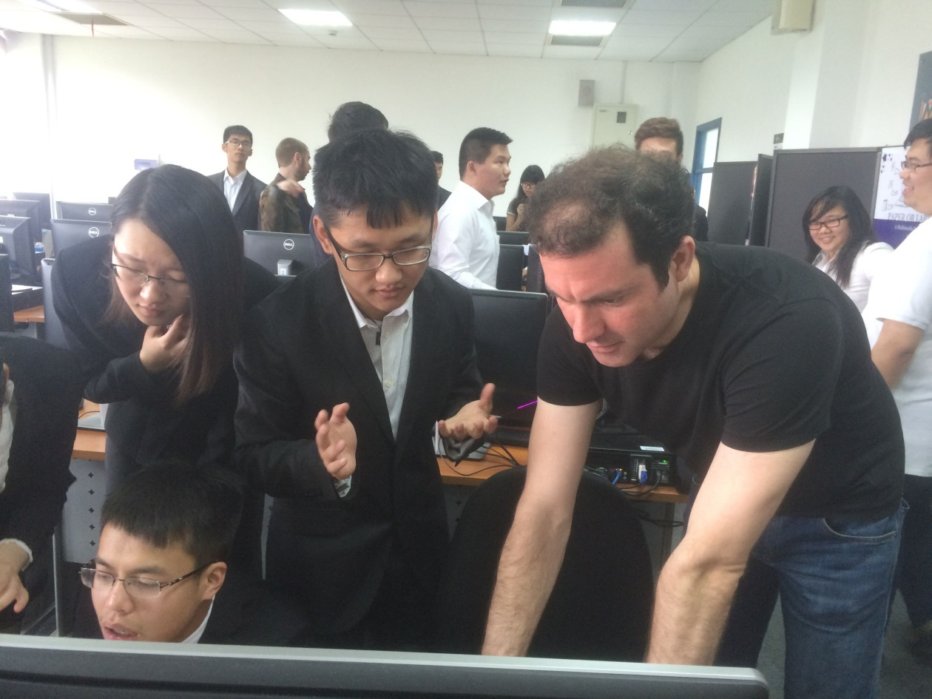
Open Day: 4 May 2016
Some photos of 2015 group project open day

Slide 23
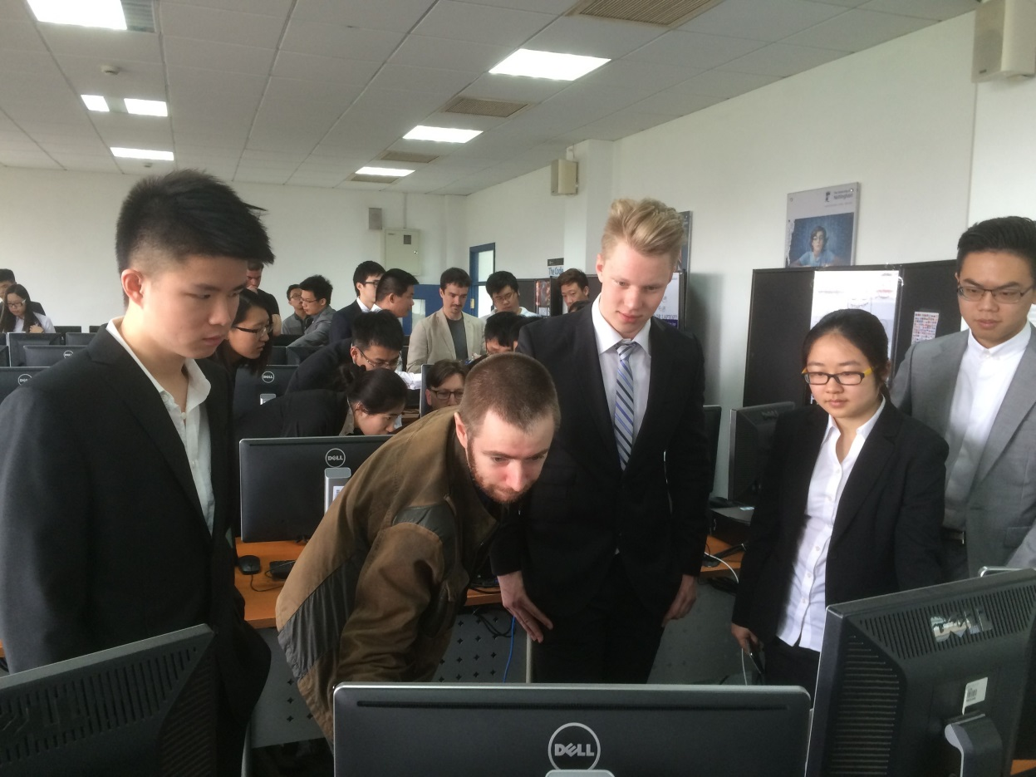
Open Day: 4 May 2016
Some photos of 2015 group project open day

Slide 24
Open Day: 4 May 2016
Some photos of UK campus group project open day

Slide 25
Open Day: 4 May 2016
Some photos of UK campus group project open day

Slide 26
Presentation Day: 4 May 2016
10 minute presentation covering
- description of the problem solved
- overview of the developed application
- reflective remarks on the success of the project
5 minutes for questions.
Attended by staff and students.
It is the quality of the presentation itself and how questions are answered that is assessed.

Slide 27
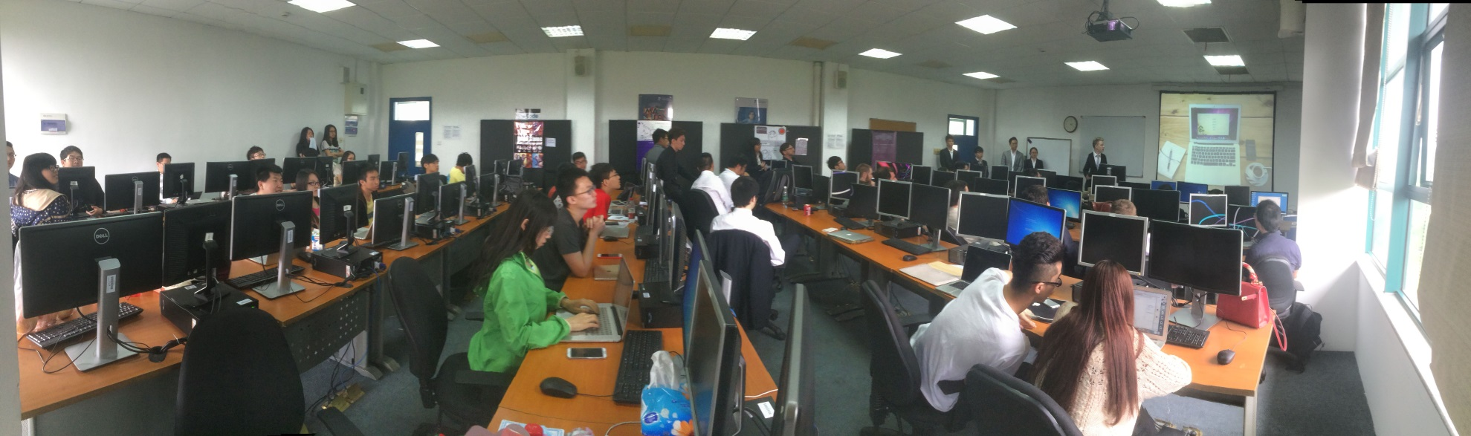
Presentation Day: 4 May 2016

Slide 28
Group Project Prizes
There are going to be Prizes! Typically:
Prize for Best Group Project (discussing with potential corporate sponsors)
School Prize for Best Open Day Stall

